Slide 1
Committee Meeting
Cassidy Northway
PhD Candidate
Sept 20 2024

Slide 2
Agenda
Accomplishments
Review Project Outline
Current Progress
New Additions

Slide 3
Accomplishments
Advanced to Candidacy
TA Professional Development Committee (2022-2024)
Northway, C., & Spadinger, I. (2023). A full body blood flow model for applications in TBI dosimetry. Radiotherapy and Oncology, 186.
Lymphoma Canada Grant (2023 – 2025)
Zhang, C., Northway, C., Crook, J., Hilts, M., & Batchelar, D. (2024). Seed distribution stability in permanent breast seed implant brachytherapy. Brachytherapy, 23(4), 433–442.
Jin, R., Oh, J., …, Northway, C., et al. The Incidence and Factors associated with Pulmonary Toxicity in Adults After Total Body Irradiation-Based Conditioning Regimens & Bone Marrow Transplantation.

Slide 4
How heterogenous is the dose delivered to the cirucalting blood volume during TBI?

Slide 5
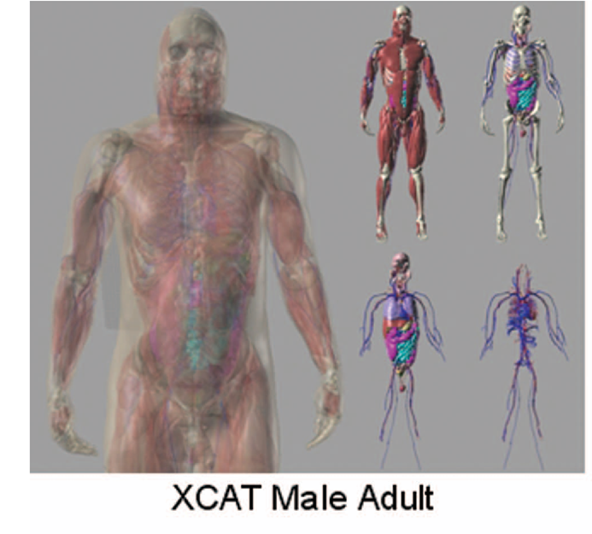
Initial Proposed Project
In-silico, track the flow of blood voxels through a whole-body phantom undergoing TBI, calculate their cumulative dose, and compare the dose to the voxels.
Whole Body Phantom (4D XCAT) model will units a blood flow model and Monte Carlo Simulations to determine dose.
Notes:
Segars, William Paul, Jason Bond, John P. Frush, Sylvia Hon, Christopher P. Eckersley, Cameron H. Williams, Jianqiao Feng, Daniel Jacob Tward, J. Tilak Ratnanather, M. I. Miller, Donald P. Frush and Ehsan Samei. “Population of anatomically variable 4D XCAT adult phantoms for imaging research and optimization.” Medical physics 40 4 (2013): 043701 .

Slide 6

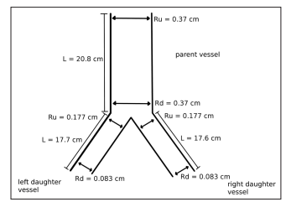
Progress to Date
Pull the geometric information from the 4D XCAT phantom
Mapped the network
Create 1D-0D blood flow modelling code base
Used open-source VaMpy code base
Modified to use Structured Tree boundary conditions.
Confirmed methodology using a “toy example”
Notes:
Diem, Alexandra & Bressloff, Neil. “VaMpy: A Python Package to Solve 1D Blood Flow Problems.” Journal of Open Research Software. 5, 17, 2017.

Slide 7
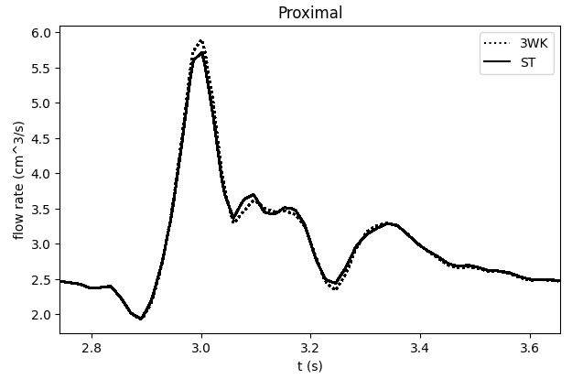
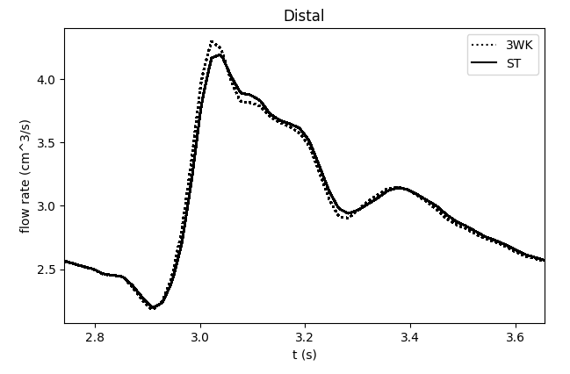
Max difference (absolute) = 0.2 cm^3/s
Notes:
Diem AK, Bressloff NW. VaMpy: A Python Package to Solve 1D Blood Flow Problems. Journal of Open Research Software. 2017;5(1). doi:10.5334/jors.159

Slide 8
Progress to Date
Pull the geometric information from the 4D XCAT phantom
Mapped the network
Create 1D-0D blood flow modelling code base
Used open-source VaMpy code base
Modified to use Structured Tree boundary conditions.
Confirmed methodology using a “toy example”
Began attempting to run a simulation for systemic arteries.
“ One problem is however, that the rather complicated system of equations does not converge for all choices of parameters (the peripheral resistance, the top radius, and the bottom radius.” – Dr. Mette Olufsen
0.006% of one period after months of work.
Notes:
Diem, Alexandra & Bressloff, Neil. “VaMpy: A Python Package to Solve 1D Blood Flow Problems.” Journal of Open Research Software. 5, 17, 2017.

Slide 9
Current Status – Blood Flow Modelling
Elected to use established geometries for a limited number of systemic arteries. [1] Already up to 4%.
It works PLZZZZ
This work will provide the basis for Paper #1.
I also have a plan to include pulmonary vessels (10%) and a limited systemic vein models. These are both based on successful implementation within the literature. CITE HERE [2,3]. This is only if time allows.
Notes:
[1] Cousins W, Gremaud PA. Impedance boundary conditions for general transient hemodynamics. International Journal for Numerical Methods in Biomedical Engineering. 2014;30(11):1294-1313. doi:10.1002/cnm.2658
[2]
[3]

Slide 10
Current Status – Beam Modelling
With my work with Dr. Popsecu preparing data for the CARO 2024 poster I’ve begun the process of modelling our sweeping Co-60.
Combining the dose data from this simulation with the blood flow model (normalized for time tracked within the simulation) will make up Paper #2.
Ideally: verification on the treatment unit, (requires access to developer mode/ 4D couch motion)

Slide 11
Questions?

Slide 12
Importance of Margin Size in TBI
Solid Tumour Treatment Planning
Total Body Irradiation Treatment Planning
CTV = Body Contour
CTV = Body Contour
PTV
CTV
The PTV extends outside of the patient’s body. Thus, we are planning to achieve the Rx in the air -> higher fluence.

Slide 13
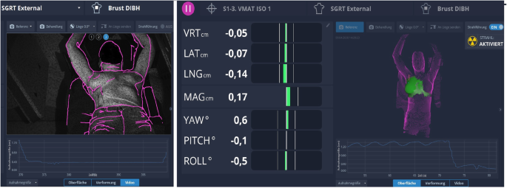
New Project – TBI Treatment Margins
BC Cancer – Vancouver has transitioned to VMAT TBI.
SGRT is used to aid in patient alignment.
This also provides with additional information on set-up error and patient motion during treatment at all isocenters
Using this data we can calculate minimum treatment margins for TBI.
Using a Robustness study we can assess how well our current margins suit our needs using treatment plans from previously treated patients.
Goal: provide treatment centre specific margins for TBI.
Notes:
Freislederer, P., Kügele, M., Öllers, M. et al. Recent advances in Surface Guided Radiation Therapy. Radiat Oncol 15, 187 (2020). https://doi.org/10.1186/s13014-020-01629-w

Slide 14
Questions?

